Slide 1
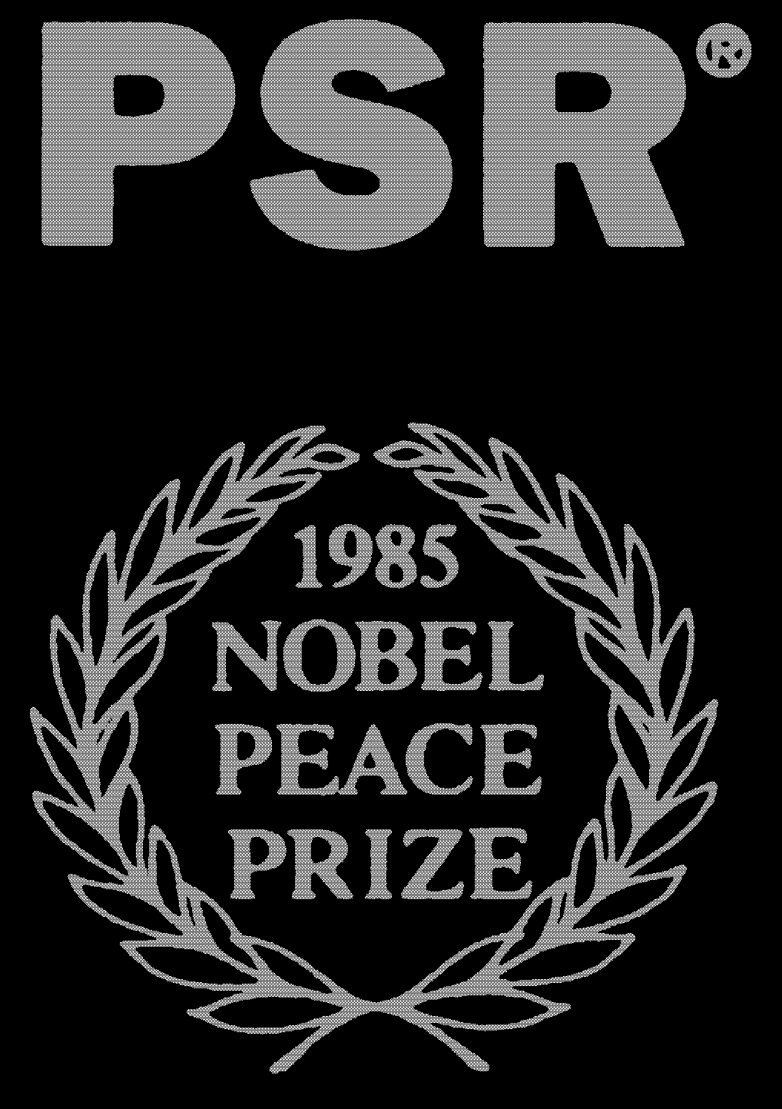
The Medical Consequences of Nuclear War
The International Physicians for the Prevention of Nuclear War
World Congress, Astana August 2014

Slide 2
World Nuclear Forces | November, 2013
United States | 7,700
Russia | 8,500
China | 250
France | 300
United Kingdom | 225
Israel | 80
India | 110
Pakistan | 120
DPRK (North Korea) | Less than 10
Source: Bulletin of the Atomic Scientists Nuclear Notebook
Notes:
I want to talk to you today about nuclear war. It is not an easy subject and what I have to say is not very pleasant to listen to. But it is very important information. Since the end of the Cold War we have acted as though the danger of nuclear war has gone away.
Unfortunately it hasn’t. There remain nearly 17,000 nuclear weapons in the world today, the vast majority in the arsenals of the US and Russia. These weapons can cause unimaginable destruction. Most of the bombs in the US and Russian arsenals today are 30 to 50 times larger than the bomb which destroyed Hiroshima.
Here is the world status of nuclear weapons currently. There are 9 nuclear nations with 17,000 nuclear weapons, but the United States and Russia have 90% of the weapons. The destruction possible from one weapon described before multiplied by the thousands.

Slide 3
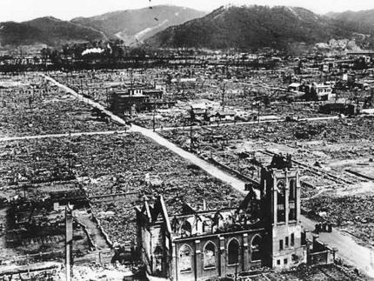
The Dangers of Nuclear Weapons Today
Hiroshima After Bombing
3
Notes:
3
Most of the bombs in the US and Russian arsenals today are 30 to 50 times larger than the bomb which destroyed Hiroshima. But if there is a war using nuclear weapons, it is unlikely that just one of these weapons will be used. Let us consider a “limited” nuclear war in which just a small fraction of the world’s nuclear weapons are used.
3

Slide 4
The Dangers of Nuclear Weapons Today
Nuclear War in South Asia
India and Pakistan, nuclear weapon states with a history of conflict
20 million deaths in major cities in India and Pakistan
Radioactive contamination throughout the region
Global climate disruption from smoke and soot
Notes:
4
4
Let us consider a regional war between India and Pakistan, involving the one hundred Hiroshima sized bombs in their combined arsenals. Such a war would kill up to 20 million people outright as the great cities of the subcontinent were destroyed, and it would blanket much of South Asia with radioactive fallout. But the global consequences are even more alarming.

Slide 5
The Dangers of Nuclear Weapons Today
Nuclear War in South Asia
Nuclear explosions ignite fires that burn whole cities
Soot lofted high into the atmosphere absorbs incoming sunlight
Dramatic decrease in amount of light reaching the surface
Large, rapid drops in surface temperature
Notes:
5
5
A recent study by Robock et al on the climatic consequences of regional nuclear war shows clearly that even this limited nuclear conflict, would affect weather patterns throughout the world. Debris injected into the atmosphere from the explosions and resulting fires would produce an average surface cooling of -1.25ºC that would last for several years. Even 10 years out, there would be a persistent average surface cooling of -0.5ºC. How significant is a drop of 1.25 C?

Slide 6
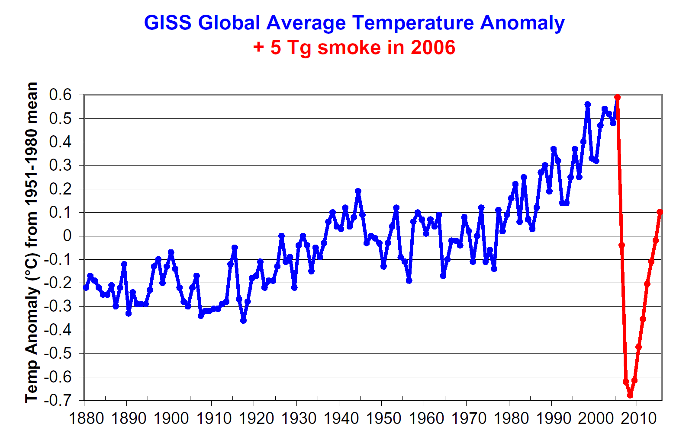
Global climate change unprecedented in recorded human history
Graph courtesy of Alan Robock
Notes:
6
This slide compares the global warming of the last 120 years with the cooling that would take place in a matter of days.

Slide 7
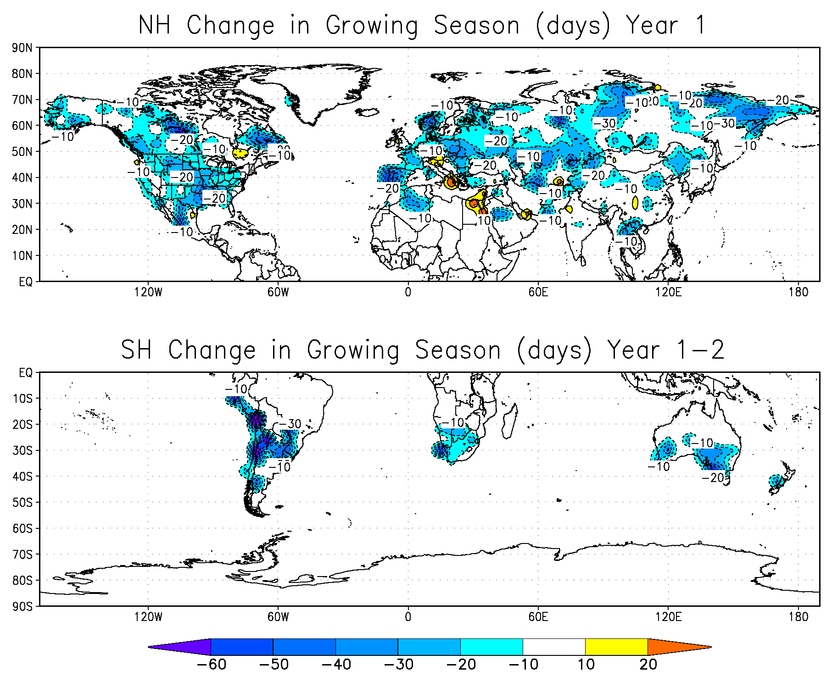
Chart courtesy of Alan Robock
Notes:
7
As a result of this cooling, there would be decreases in the growing season (frost free days), of 10 to 20 days in many of the most important grain producing areas throughout the world. This decrease might “completely eliminate crops that have insufficient time to reach maturity.”

Slide 8
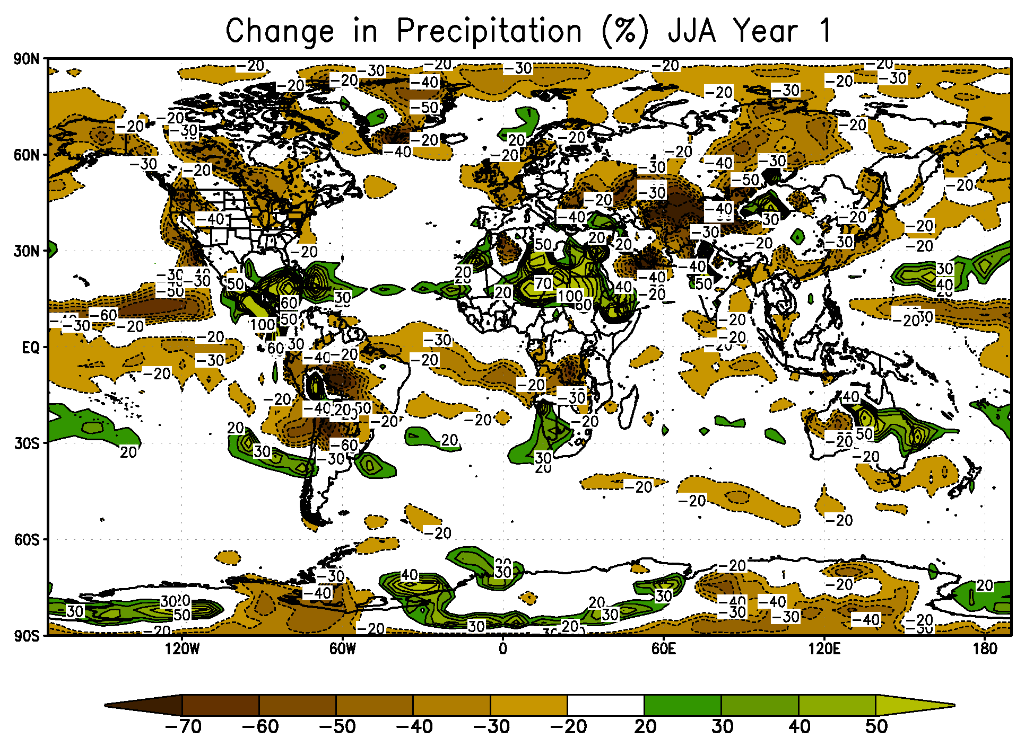
Chart courtesy of Alan Robock
Notes:
8
There would also be major alterations in patterns of precipitation, with a 10% reduction in global rainfall, and large reductions in the Asian summer monsoon.
The most important direct effect of these changes in temperature and precipitation would be a decrease in global food production. While there are no accurate estimates of the shortfall in food production available at this time, there is historical experience from previous cooling episodes which suggests the impact on food supplies would be very large.

Slide 9
Nuclear War: The Impact
on Agriculture
Sudden cooling shortens the growing season, and decreased sunlight, with less rainfall all reduce crop yields
Stratospheric ozone depletion damages crops sensitive to UV-B
Disruption of petroleum supplies affects use of farm machinery and fertilizer and pesticide production
Radioactive and toxic contamination takes farmland out of production
Collapse of distribution system
Notes:
9
The cooling and lower precipitation would cause significant declines in food output. Several other factors might affect the size of available food stocks in the event of a regional nuclear war. The soot injected into the atmosphere in a nuclear war would cause significant ozone depletion, that would allow much more ultraviolet light to reach the earth and could cause a further major decline in actual food production. Disruption of petroleum production would also cause a serious decline in food production which is dependent on petroleum based fertilizers and pesticides and on petroleum fueled tractors, water pumps, and trucks. Furthermore food that was grown might be diverted to offset the loss of available gasoline. . Today ethanol production is already using significant quantities of grain that would otherwise be available as food or livestock feed. Finally, if a regional war resulted in significant radioactive contamination of one or more major food producing countries, large quantities of food might need to be destroyed and significant areas of crop land might need to be taken out of production.

Slide 10
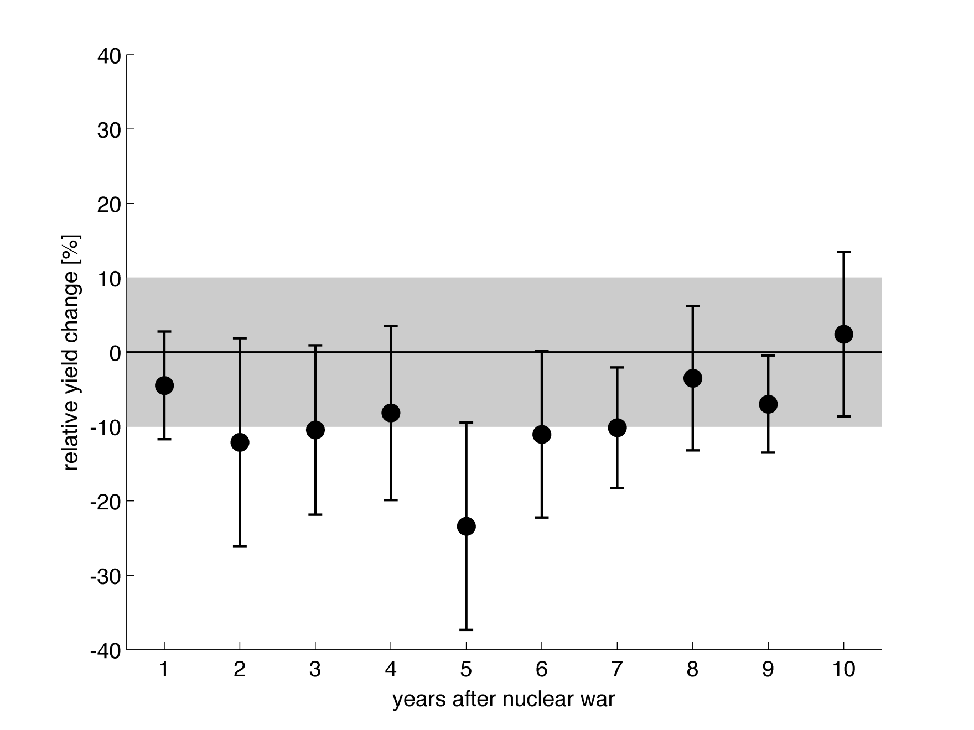
Per Cent Decline in Corn Production over Time
Courtesy Mutlu Ozdogan
Notes:
A number of studies have looked at the magnitude of the decline in food production in the US and China. In the US corn production declines an average of 12% over a full decade. The decline varies significantly over time. The sharpest decline occurs in year 5 when production is down by more than 20 %

Slide 11
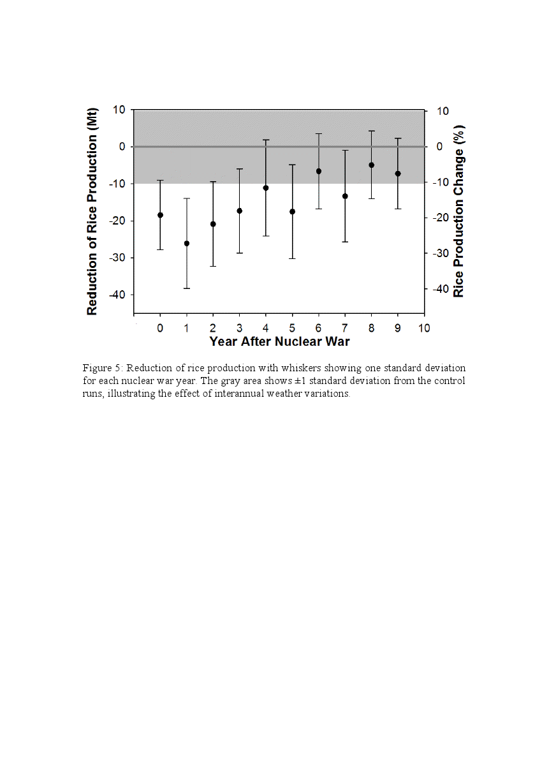
Decline in Rice Production Over Time
Courtesy Lili Xia
Notes:
In the case of Chinese rice production, the projected decline is 17% over 10 years, and the largest impact is in the first three years, although there is also a significant dip in the 5th year after the war.

Slide 12
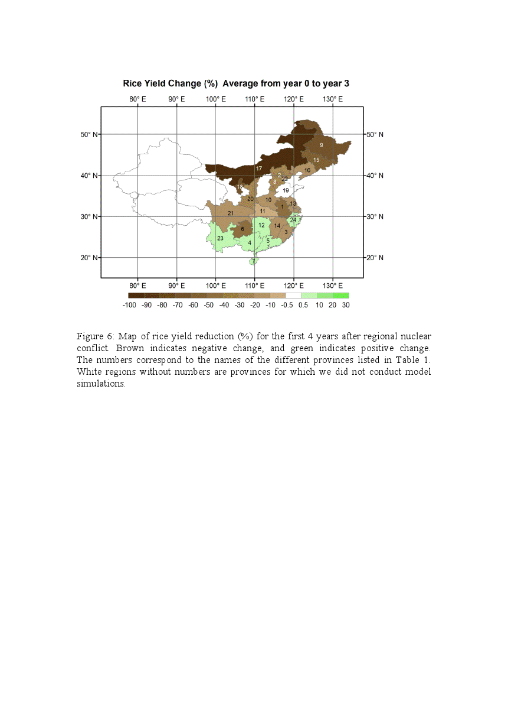
Change in Rice Yield by Province
Courtesy Lili Xia
Notes:
In the case of China there is also significant variation in the impact on rice production in different provinces. In some provinces in the South and East of China, rice production actually increases. But in the North and West, the declines are much greater than the national average.

Slide 13
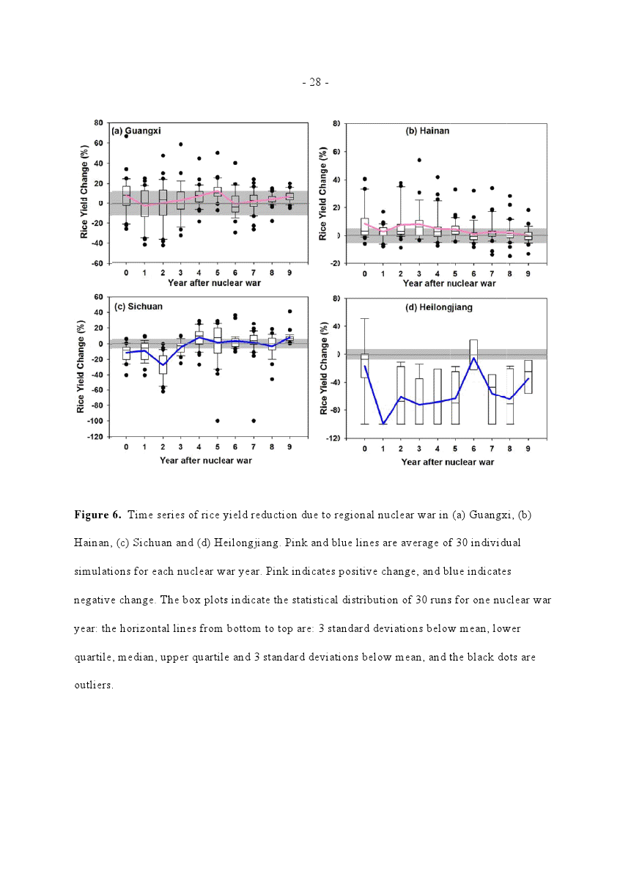
Courtesy Lili Xia
Notes:
In Helongjiang, home to 36 million people, rice production is less than half normal for 5 years, and in year 1 after the war the crop fails completely.

Slide 14

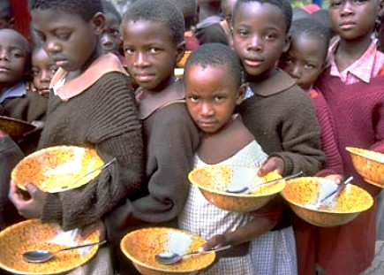
Notes:
14
At this point in time, we are ill prepared to deal with a major fall in world food supply. Global grain stocks are equal to approximately 70 days of consumption, dramatically lower than the 100 to 120 days of consumption available in the 1980’s and 1990’s. These stocks would not provide an adequate reserve in the event of a sharp decline in global production.

Slide 15

Chronic Malnutrition Today
1,800-2,200 calories
minimum daily requirement
825 million people at or below
this level of daily intake
Notes:
15
Furthermore, at baseline there are already millions of people suffering chronic malnutrition. The average adult needs somewhere between 1800 and 2000 calories per day, depending on his or her stature, to meet basic metabolic requirements and sustain a minimal level of physical activity Requirements for children are dependent on age and size. There are more over 800 million people in the world whose daily caloric intake falls below these minimum requirements. Each year some five million children in this group starve to death. A small further decline in available food would put this entire group at risk. There are also 300 million people in the world who are well nourished today, but live in countries that are
dependent on food imports. They too would be at risk.
In addition there are hundreds of millions of people who have adequate food consumption now but who live in countries where much of the food is imported. For example, North Africa, home to more than 150 million people, with average caloric consumption well above the minimal level, imports 45% of its food. A number of other countries in the Middle East, plus Malaysia, South Korea, Japan and Taiwan are also dependent on imports for 50% or more of their grain consumption. All told, an additional several hundred million people would be at risk if there was a major interruption in international grain trade

Slide 16
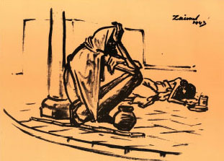

Great Bengal Famine of 1943
Food production declined only 5%
Actually 13% higher than 1941
when there was no famine
3 million people died
International Physicians
for the Prevention of Nuclear War
Notes:
16
Given these conditions, even a modest, sudden decline in agricultural production could trigger massive famine. At the time of the great Bengal famine of 1943 food production was only 5% less than it had been on average over the preceding five years, and it was actually 13% higher than it had been in 1941 when there was not a famine. But in 1943, after the Japanese occupation of Burma, which had historically exported grain to Bengal, the decline in food production was coupled with panic hoarding and the price of rice rose nearly five fold, making food unaffordable to large numbers of people. These two factors, hoarding and the severe increase in rice prices, caused an effective inaccessibility of food far more severe than the actual shortfall in production. And 3 million people died.
In the event of a major global cooling episode caused by a regional nuclear war we would expect to see dramatic rises in food prices and hoarding on a global scale as countries that normally export grain held on to any surpluses they had to feed their own people.

Slide 17

1 billion dead
from starvation alone?
Notes:
17
If famine conditions persisted for a year or more, it seems reasonable to fear that the total global death toll could exceed one billion from starvation alone.

Slide 18
Percent Decline Chinese Grain Production Following Limited Nuclear War
First 5 Years 10 Years
Maize 17% 16%
Middle Season Rice 20% 17%
Winter Wheat 39% 31%
Courtesy Lili Xia and Alan Robock
Notes:
That was out understanding of the danger when we published the original study on nulcear famine in 2012. Since then new data has emerged on food production in China which suggests that we may have seriously underestimated the extent of the famine that might follow a limited nuclear war. The new data confirm the large decline in Chinese rice production, but show an equal decline in Chinese maize production and a catastrophic 31% declline in winter wheat production.

Slide 19
Two billion dead
from starvation alone?
Notes:
19
Previously we had assumed that China would be spared significant famine. These new data suggest that in fact there will be major short falls of food in China that will put an additional 1.3 billion people at risk, and, at the very least lead to a decade of economic and social turmoil in the largest country in the world, home to the world’s second largest and most dynamic economy and a large nuclear arsenal of its own.
Previously we had assumed that China would be spared significant famine. These new data suggest that in fact there will be major short falls of food in China that will put an additional 1.3 billion people at risk, and, at the very least lead to a decade of economic and social turmoil in the largest country in the world, home to the world’s second largest and most dynamic economy and a large nuclear arsenal of its own.
World wide the famine could put more than 2 billion people at risk.

Slide 20
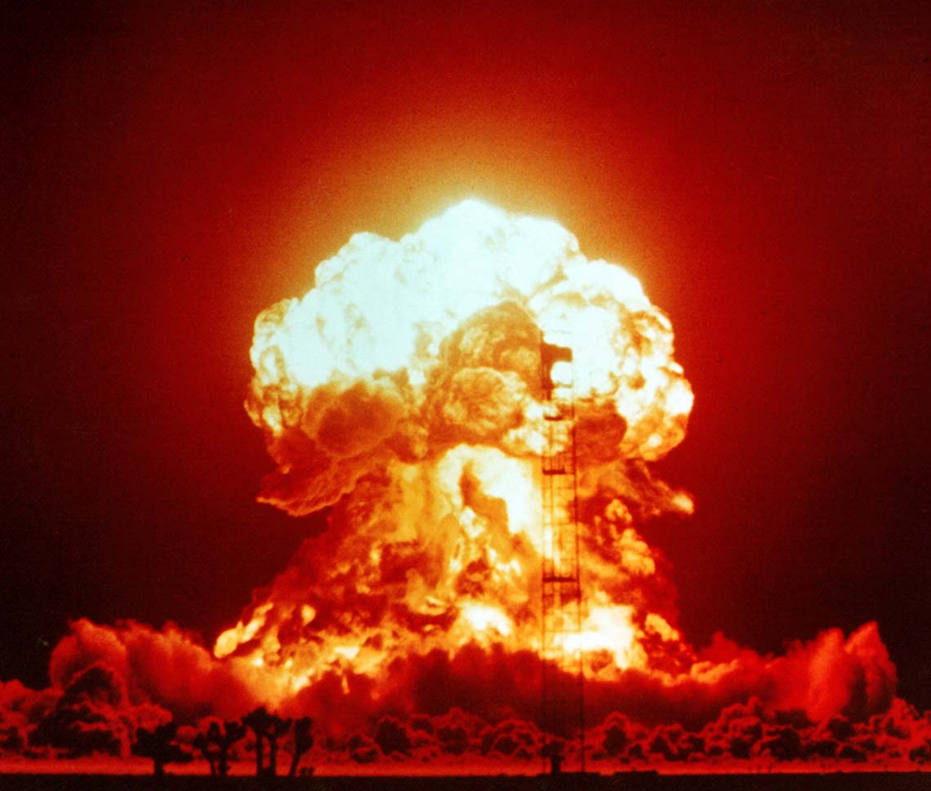
Notes:
20
These findings have enormous implications for South Asia and for the way the rest of the world reacts to events in South Asia. But they have even greater implications for the nuclear policy of the larger nuclear weapon states. Each US Trident submarine carries 96 warheads each of which are 10 to 30 times more powerful than the weapons used in the South Asia scenario. That means that each of these subs can cause nuclear famine many times over. And the US has 14 of them, plus land based missiles and strategic bombers. The Russian arsenal has the same insane level of overkill capacity. Altogether they have nearly 15,000 nuclear weapons, of which some 1800 are on hair trigger alert and can be launched in less than 15 minutes.
So let’s consider what these weapons can do. Let me start by describing the effects of a large scale nuclear attack on a major city.
I am going to use the model of a 20 megaton bomb, 1700 times more powerful than the bomb that destroyed Hiroshima. In the 1960’s both the US and the Soviet Union had 20 megaton weapons. Since then, their arsenals have been modernized. An attack today on a major city like New York or Moscow would involve not one 20 megaton bomb, but 10 to 15 half megaton weapons. The megatonage would be less. The destruction would actually be greater because it would be spread out more evenly over the entire metropolitan area. But it is hard to describe the effects of many weapons going off at the same time, Although the model I am using underestimates the damage, it provides an adequate approximation of the devastation that would result in a large scale nuclear attack.

Slide 21
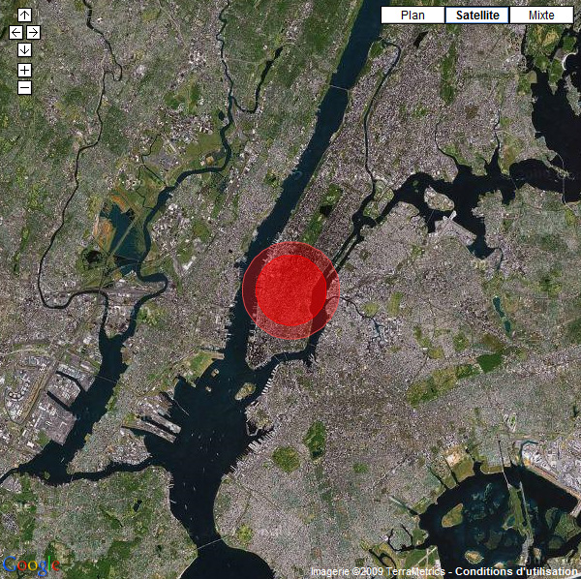
Notes:
Within 1/1000th of a second of the detonation of this weapon, a fireball would form reaching out for two miles in every direction, four miles across. Temperatures would rise to 20 million degrees Fahrenheit, and everything--buildings, trees, cars, and people--would be vaporized.

Slide 22
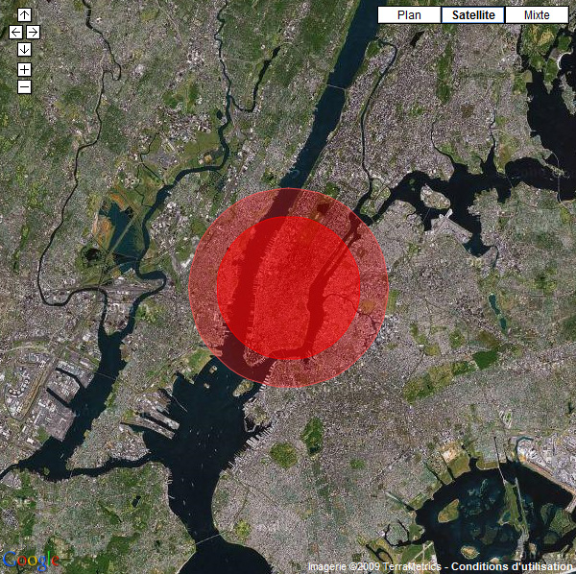
Notes:
To a distance of 4 miles in every direction, the blast would produce pressures of 25 pounds per square inch and winds in excess of 650 miles per hour. Forces of this magnitude can destroy essentially anything that we build including reinforced concrete and steel structures. Even deep underground bomb shelters would be crushed.

Slide 23
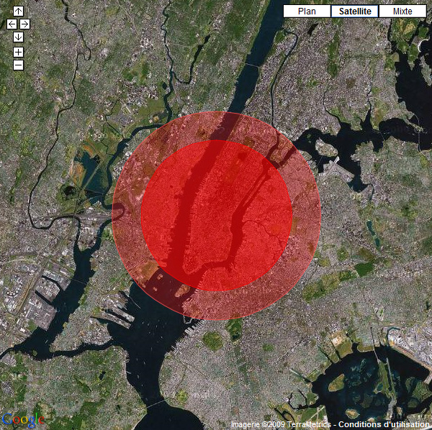
Notes:
To a distance of six miles in every direction, the heat would still be intense enough to melt automobiles.

Slide 24
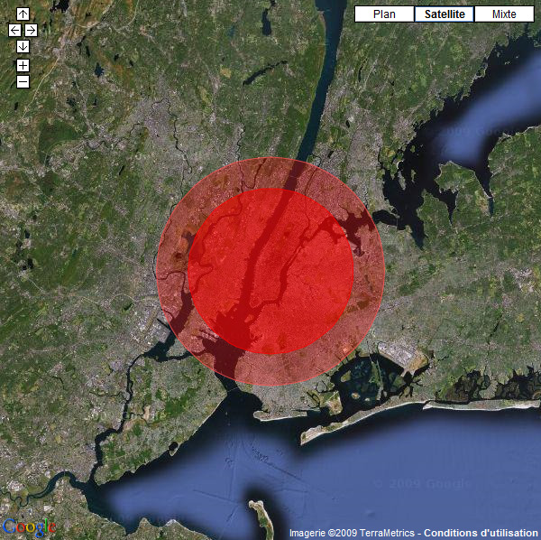
Notes:
To a distance of 10 miles in every direction, and note that I have had to change the scale of the map to accommodate the expanding zone of destruction, the blast wave would create pressures of 7 to 10 pounds per square inch and winds of 200 miles per hour. Forces of this magnitude would level wooden and masonry buildings. In modern steel and concrete structures, the wall and floors would be swept out; a steel skeleton would remain.

Slide 25
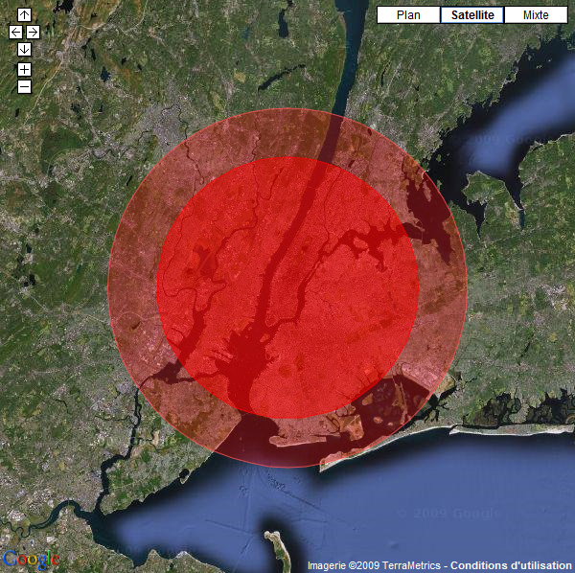
Notes:
To a distance of at least 16 miles in every direction, the heat would ignite everything that burns--paper, cloth, wood, leaves, gasoline, heating oil--starting hundreds of thousands of fires. Fanned by blast winds still in excess of 100 miles per hour, these fires would merge into a giant firestorm more than 30 miles across and covering 800 square miles. Everything within this entire area would be consumed by flames. Temperatures would rise to 1400 degrees Fahrenheit. All the oxygen would be consumed And every living thing would die. In the case of New York we are talking about 15 million people dead in a half hour.

Slide 26
A Human Health Disaster
Hundreds of thousands of patients with severe burns
Crush injuries, collapsed lungs, blindness from retinal burns, deafness from perforated ear drums
Notes:
26
Beyond the firestorm, the destruction would continue and there would be millions of injured. In the immediate post attack period, burns would constitute the most common and serious medical problem. Hundreds of thousands of people would have sustained major second and third degree burns, some from the direct effects of the heat flash on exposed skin, others injured in the thousands of fires that would rage on the periphery of the great firestorm. These people would need urgent and intensive medical therapy. It would not be available. In the entire United States, there are only 2000 special beds for burn patients. And most of these would have been destroyed by the bomb. At best, a tiny fraction of the hundreds of thousands of burn patients would receive appropriate medical care. The rest would die. In addition to these burn patients there would be many hundreds of thousands of other injuries. People blinded by the flash or deafened when the pressure wave ruptured their ear drums. People with lungs collapsed by the tremendous pressures. People with stab wounds from flying debris. People with bones broken when they had been hurled through the air by the hurricane force winds or trapped under collapsing buildings
And if this attack were part of a large scale war between the US and Russia, the same level of destruction would be seen in every major city in the US and Russia, and if NATO were drawn into the conflict, in most of the great cities of Canada and Europe as well. A 2002 study showed that if only 300 bombs in the Russian arsenal hit targets in US cities, 75 to 100 million people would die in the first half hour, and the entire infrastructure needed to support the rest of the population would be be destroyed. The public health system, the communications network, the banking system, the food distribution system: it would all be gone. And tn the months following this attack, the majority of the population in the affected countries would die from exposure to the elements, from starvation, from radiation sickness and epidemic disease.

Slide 27
Surface Air Temperatures 2 years after 150 million tons of smoke enters stratosphere
Decrease in Surface Air Temperatures 2 years after full-scale nuclear war
Notes:
27
But even this is not the full story. Because this attack would cause the same kind of climate disruption as a limited nuclear war, but on a much larger scale. The South Asian scenario pumps 5 million tons of debris into the atmosphere; a war involving only those weapons that will remain in the deployed arsenals of the US and Russia when the New START treaty is fully implemented in 2017—that war puts more than 150 million tons of soot into the upper atmosphere. And that drops temperatures not 1.25 degrees, but 8 degrees C. In the interior regions of Eurasia and North America temperatures drop 20 to 30 degrees to levels not seen on Earth in 18,000 years since the coldest time of the last ice age. Ecosystems would collapse, food productin would plummet. The vast majority of the human race would starve and we might become extinct as a species.

Slide 28
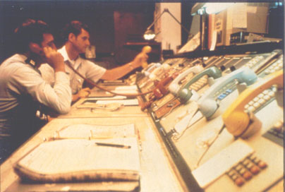
Accidental Nuclear War
Accidental launch due to misinformation, fear, human error or computer malfunction is a serious and real threat.
Thousands of nuclear weapons could be fired within a few minutes notice.
Notes:
28
It is important that we understand that this is not just some theoretical scenario that I have sketched out but a danger which is real and present. For 25 years we have been told that we do not have to worry about nuclear war between the US and Russia. The crisis in Ukraine has shown how hollow those assurances are. Even if we do not stumble into the intentional use of nuclear weapons, there remains the danger of accidental war.

Slide 29
November 9, 1979
June 3, 1980
September 26, 1983
November 7, 1983
January 25, 1995
Notes:
We know of at least 5 occasions since 1979 when either Moscow or Washington prepared to launce nuclear war in the mistaken belief that they were themselves already under attack. On November 9, 1979 a training tape was accidentally loaded into the main computer at the US command center simulating a full scale Soviet attack on the US. In June 1980 a computer chip malfunction again caused a false indication of Soviet attack. In September 1983 a Soviet computer error simulated a US attack on Russia, and in November 1983 the Soviet leadership mistakenly concluded that a large scale NATO exercise, Able Archer 83, was the cover for a planned surprise attack on the Soviet Uniton..Most recently, on January 25 1995, a full 5 years after the end of the Cold War. the US launched a weather rocket from Norway. In accordance with international arrangements the US notified the Russians in advance of this launch, but someone in Moscow failed to pass the notice on. The Russian military was not expecting the launch. Since the Russians know that the US always keeps nuclear missile submarines in the North Atlantic off the coast of Norway, when the launch was picked up on radar they interpreted it as a possible missile attack. For the only time that we know of, the special briefcase that the Russian President carries at all times to order the response to nuclear attack was activated. President Yeltsin, a man with serious health and alcohol abuse problems, was given a series of options that ranged from doing nothing to launching a full scale attack on the US. And he was given about 5 minutes to decide. Russian and US nuclear forces are guided by the doctrine of launch on warning. If either side believes that they are under attack they are supposed to counter attack immediately and not wait for the other side’s missiles to actually explode. We do not know exactly what happened in the Kremlin that morning. But Yeltsin, or someone acting for him, decided to wait, and in a few minutes it was clear that the blips on the radar screen were not moving towards Russia.
January 25, 1995 was an ordinary day, in a safer time than our own. There were no great crises anywhere in the world. And yet we came within 5 minutes of destroying ourselves. We simply can not count on being that lucky the next time. There may have been other similar episodes—these are the ones that have made it into the public record. I began this talk by discussing the possibility of terrorists setting off a small nuclear weapons in one city. The even greater danger is that terrorists will hack into the command systems of either the US or Russia and launch one or more nuclear missiles and triggering a large scale nuclear war.

Slide 30
This is not the future that must be.
But it is the future that will be if we do not act.
Notes:
This is the danger we face.

Slide 31
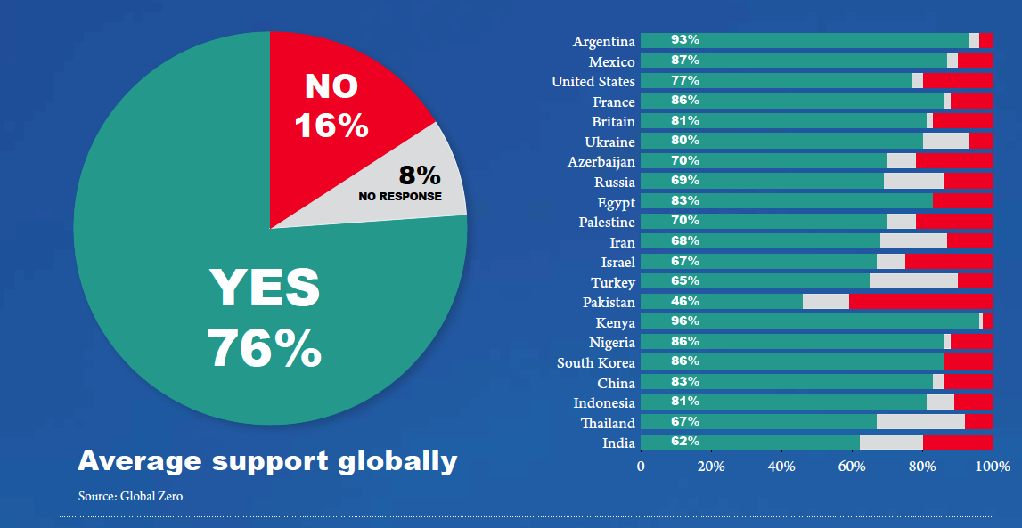
World Opinion – Nuclear Disarmament?
Notes:
Fortunately, there is enormous public support around the world for the elimination of nuclear weapons

Slide 32
Humanitarian Impact
of Nuclear Weapons
Conference 1: Oslo, Norway March 2013
127 nations represented
Conference 2: Nayarit, Mexico February, 2014
146 nations represented There were also 119 representatives from civil society organizations, ten UN and non-UN international organizations and agencies, 35 national Red Cross and Red Crescent societies, as well as legislators and academics.
Conference 3: Vienna, Austria Fall, 2014
Notes:
Nations all over the world have grown impatient with the nuclear weapons states. The government of Norway hosted the first conference on the Humanitarian Impact of Nuclear Weapons in Oslo in March, 2013, and 127 nations sent official delegations. For the second conference, in February, 2014, 146 nations participated. That is three quarters of all the nations of the world. The next conference is scheduled for Vienna this fall.

Slide 33

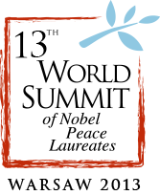
United Nations General Assembly 1st Committee 124 Nations Joint Statement on the Humanitarian Consequences of Nuclear Weapons Delivered by the ambassador from New Zealand October 21, 2013
"The only way to guarantee that nuclear weapons will never be used again is through their total elimination.“
Nobel Peace Laureates' Statement: Nuclear Abolition is a Humanitarian Imperative October 24, 2013
“Nuclear weapons are an existential threat to humanity, and must never be used again, under any circumstances. We therefore welcome the recent shift in the international discourse about nuclear weapons towards the recognition by a number of States that the catastrophic and irremediable consequences of the use of nuclear weapons require decisive action to outlaw and eliminate them.””
Notes:
The momentum of the Humanitarian Impacts initiative is building.

Slide 34

COUNCIL OF DELEGATES
OF THE INTERNATIONAL RED CROSS AND RED CRESCENT MOVEMENT
Working towards the elimination of nuclear weapons: Four-year action plan Resolution adopted: Nov. 18, 2013
Sydney, Australia
Notes:
In November, 2013, The International Red Cross adopted a four year action plan for the elimination of nuclear weapons at their Council of Delegates meeting in Sydney.
The Red Cross is an example of one International organization that has taken a stand for nuclear disarmament.is The International Red Cross. For years now, the organization has made clear statements that there is no adequate international response to the destruction possible with nuclear weapons

Slide 35

Hope for a World Free of Nuclear Weapons
Treaty to Ban Nuclear Weapons
IPPNW affiliates globally working toward a Ban Treaty
UN Secretary General calls for support for ICAN
Notes:
35
Several years ago, IPPNW launched ICAN, the international campaign to abolish nuclear weapons. ICAN has now grown into a movement of more than 360 NGOS’s worldwide. We are seeking to build support worldwide for a Treaty to ban these weapons from the arsenals of all nations.
35

Slide 36
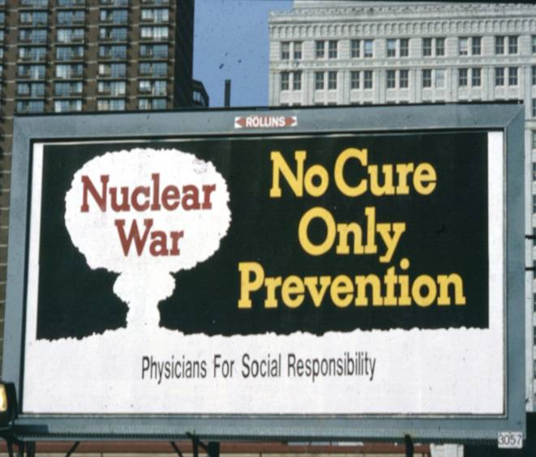
Notes:
36
36
We have a lot of work to do, but we know that if a problem can not be cured, it must be prevented. And we know that nuclear weapons can be abolished if we can successfully educate the public and decision makers and create the political will to abolish them.

Slide 37

Notes:
37
37

