Slide 1
One Bullet Story series The Socio-economic Impacts of Firearm Violence in Lusaka, Zambia
“THERE IS NO CHEAP BULLET”
Notes:
GUN VIOLENCE GOES FAR BEYOND THE REACH AND RANGE OF THE FIRED BULLET. Though a bullet is an inexpensive piece of metal, the cost associate with management of the socio-economic consequences are phenomenon. A bullet may be discharged from a legally owned Firearm, illegally held Firearm, from a military style Firearm, from a Firearm in civilian possession- yes it may be fired in inner city crime, unintentionally, used in homicide, suicides, genocide, yet as far as health impacts are concerned, the outcome or conclusion, according to Robin Coupland, a field surgeon with the International Committee of the Red Cross, is one:- Guns are bad for People’s health…”

Slide 2
Presented by: Dr Robert E Mtonga International Physicians for the Prevention Of Nuclear War, IPPNW/Zambia

Slide 3
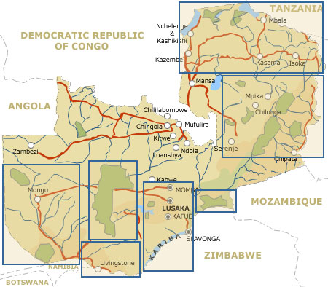
MAP OF ZAMBIA

Slide 4
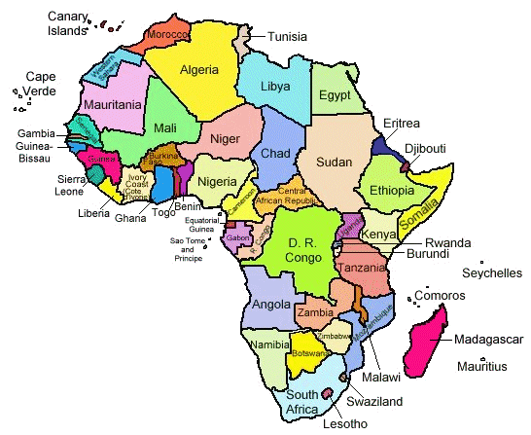
MAP OF AFRICA SHOWING ZAMBIA`S LOCATION

Slide 5
Firearms-related violence is not considered as a public health issue in the same way HIV/AIDS, Malaria, Tuberculosis, malnutrition, among others are.
In Zambia, this scourge is discussed as a security and criminal justice issue.

Slide 6
The following “One Bullet Stories” of gunshot victims at a Lusaka hospital prove that small arms are a public health threat in Zambia.
The medical community needs to become involved to help stop the injuries and deaths.

Slide 7
Surgical visits to the University Teaching Hospital in Lusaka
The UTH has five general surgical wards &
7 surgical subspecialties.
Cases profiled give a flavour and extent of the problem (1998-2002).
UTH sees about 1/3 of gunshot incidents Lusaka.
Some cases are not admitted to the wards.
Other gunshot injuries seen in private health units.

Slide 8
SOME ILLUSTRATIVE CASES Case#1
Male/13 Years, sustained gun shot wounds to the face.
AK47 used in felony-from DRC (police)
Reconstructive surgery, a tracheotomy, gastrostomy, 3 units of blood, intensive care unit ventilatory support.
Spent 14 days in hospital.
Needed 16 weeks follow-up.
Cost health care system US$ 3000.

Slide 9
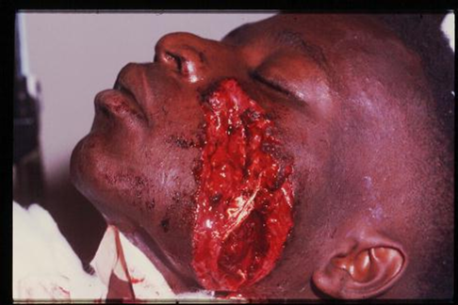

Slide 10
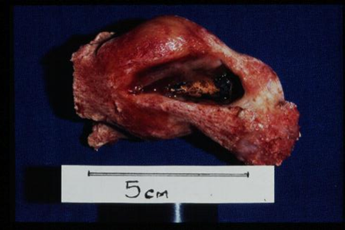

Slide 11
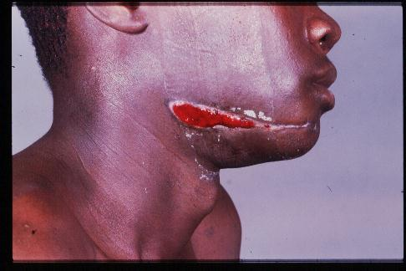

Slide 12
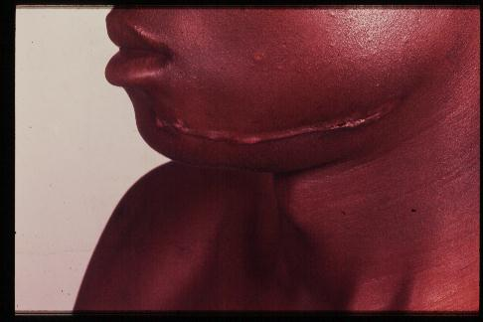

Slide 13
Case # 2
Male/33, sustained multiple bowel
perforations from gun shot injuries.
Needed a laparotomy to repair the bowels.
Developed complications along the way.
Discharged from hospital after 27 days.
Cost the health system around US $2000.

Slide 14
Case #3
Male 7/years, with skull bullet injuries, sustaining brain herniation.
Took over 3 hours theatre time, resuscitation, removal of damaged bone and skin chips. Bandaged and taken to the intensive care unit.
Died same day.
Cost hospital US $1000.

Slide 15
Case #4
Female/13 years, with multiple intra-abdominal gun shot injuries.
Need laparotomy to repair the large bowels and kidney.
Died one day later from haemorrhaging.
Cost hospital US $1200.

Slide 16
Case # 5
Male/19, shot in the abdomen, sustained injuries to the urinary bladder, liver, stomach and large colon.
Needed a laparotomy to repair the damaged organs, lasting over 2 hours, stayed 7 days in hospital.
This visit cost the hospital about
US$ 1500,excluding secondary costs such visits from relatives and friends, lost productivity, psychological trauma etc.

Slide 17
Case #6
Female/2 years 6 months old, shot in the knee with damage to the vasculature.
Needed exploration of the wound and ligation of the bleeders.
Spent 8 days in hospital.
Cost the health care system about US$ 700.

Slide 22
Contextual Issues
Huge Burden of Preventable Diseases and Death
High incidence and prevalence of HIV/AIDS with opportunistic infections such as TB, diarrhoeal diseases etc.
High malaria incidence & resistance of Plasmodium to the cheaper drug chloroquine.
Rising cases of Non-communicable diseases.
Inadequate resources to finance health service provision. This gives rise to:
Erratic supply of drugs and other supplies.
Dilapidated infrastructure and equipment
Lack of health facilities to undertake specialised treatment in the country.
High attrition rates among the core health workers in the public sector.

Slide 23
The Resource Envelope
The WHO Commission on Macroeconomics has estimated that Zambia needs a per capita expenditure of $33 in order to deliver the Basic Health Care Package.
From 2000 to 2004, the per capita expenditure on health has only averaged $18 inclusive of public & and private expenditure.
Provision of public health services at primary & secondary level require at least $12 per capita.

Slide 24
The Resource Envelope
This is exclusive of the following costs
Tertiary level care
Co-artem as the first line drug for malaria;
HIV/AIDS interventions (VCT, PMTCT, ART)
Residual indoor spraying for malaria;
DPT+ Hib vaccines
Currently these are supported through
Global Funds
Multilateral organizations
Pepfar

Slide 25
One Bullet is Too Costly
The costs of direct health costs are truly enormous.
Zambia’s health budget is USD $18/person/year
The costs of gun violence are varied:
* Physical costs - disability, eyesight loss.
* Social costs, i.e. dependence, identity crisis arising from changed status
* Economic costs - arising from medical costs, mental health costs quality of life costs among other things.

Slide 26
FURTHER COSTS
Hiring of security agents for protection of persons and property arising from fear of being attacked by armed elements.
Erection of perimeter walls around premises.
Creation of a culture of violence.
Scaring off investors.
Increased policing costs.

Slide 27
ONE CONCLUSION
Medical community - Get Involved!
Help:
Stop One Bullet From Being Fired.
Join The Call For An Arms Trade Treaty.
Support The Implementation Of The SADC Protocol.
Support Stricter National Gun Laws.
Educate Colleagues About The Urgent Need To Stop Gun Violence.

Slide 28
Acknowledgements
We thank the following funders for supporting this work:

